Slide 1
Commercial Detector
Nikita Kodkani
Twitter: @NikitaKodkani
Notes:
Before moving towards my proposal let me ask..
1. That how many of you record the movie or television shows to watch it later?
How many of you find Ads noisy and irritating?
Think about this situation, you are watching a really interesting television show or movie like Wazir that you have recorded it.
You are engrossed into the show, and the show/movie is at the climax.. & snap its commercial break !
I am sure you have been in such situation and its most annoying thing.. But what if u could eliminate it? What if there is system that could remove it?
Commercial detector is an automated and robust commercial detector system - one that is generic for all TV, regardless of the language/country/genre of the TV show

Slide 2
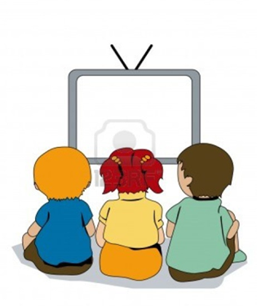

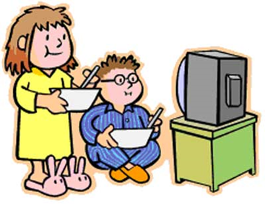
Why should I use Commercial Detector ?
Viewers
Ad Advertisers
Broadcast Regulators
Notes:
Advertising is a means to introduce a product and then publicize it.
B)The advertisers might want data - optimizing the revenue:
timings of their ad/ frequency of ad/develop publicity strategy
C)Broadcast regulators:
Data about the quantum of advertisement/ quality/length and decency..so as to have an eye on advertisers..whether they are following the various regulations regarding advertisement broadcasting..
They currently need a full time TV viewer dedicated for the sole purpose of watching the programs and pinpoint the advertisements which are not abiding the law.

Slide 3







How humans detect commercials?
Anchor
message
Text
Logo
Notes:
This is most naive question ..but can one tell me ..how do they differentiate between commercial and TV?
It is easy for our brain to identify it as commercial but its hard for computer to identify…
Have u observed the slight increase in audio when commercial is playing?
How do you differentiate between multiple commercials?
How do you know that this is the ad of Lux or Dove?
Every Ad has its brand name or the logo mostly at the end of the commercial..

Slide 4
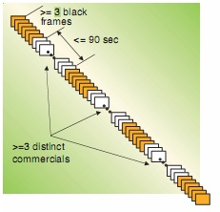
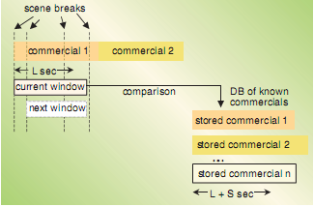
Commercial Detection Schemes:
Feature based detection – inherent characteristics
Recognition based detection- search stored commercial in database
Notes:
A TV broadcast (a series of videos) merged together in unit. Many advertisements and many blocks of the same TV show are combined in the desired order to obtain a broadcast.
videos have to be joined together until there is no blank frame/silence frame between the two videos, this way humans cannot detect scene changes and the transition will be smooth. From the laws of physics we know the light travels faster than sound, so during broadcasting, if there was no silence between the audio content of the combining videos, you would be seeing a little of the second video while hearing the last part of the first video, this would make the transition noisy, for this reason they always leave a gap of silence at the scene change point.
Features based detection depends upon such inherent characteristics of TV.
Other e.g: commercial bumper (germany)/ timer (Japan)
Other is the recognition based detection – where we store logos of the commercial into the database and identify the individual ads
Combining both the detection schemes we have designed robust system which would be useful for both viewers and advertisers

Slide 5
Building learning algorithm
Notes:
The only resource at my reach was access to HD videos of TV recordings, my task was to build a commercial detection system from this. My first thought was, a human divides the video in to blocks, based on how different the blocks are and then designates whether that block was a commercial or not. Even though this exact process of how the mind divides it into blocks and later classifies them was rather obscure, I went ahead to implement it.

Slide 6




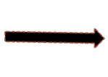
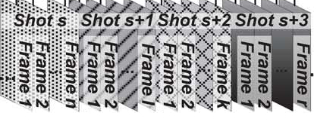
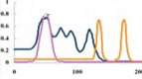
Commercial (Logo / Text / Anchor Message)
Processing box
Skip
Logo
No
Text
Frame processing
Is
Commercial ?
Recoded TV program
Anchor
message
Yes
Sampling audio
High amplitude
Output
Ad name
Count
Silence detection
6
12/1/2016

Slide 7
Commercial Block detection:
Black frame detection
Audio frame detection
Notes:
To detect the block of the commercial (having multiple commercials) will use the black or the silence frame discussed earlier
Along with it also uses - the high frequency node

Slide 8

Detect Individual Ads
Notes:
Advertisers want to know the frequency of the ads shown. We have stored the individual ads- logo (images) in databases. We are mapping the video frames (image) to the logo.. Using SURF pattern matching algorithm (in opencv)
We had other options as well like SIFT but due to speed - choose SURF
Gray scale – remove noise (Gaussian filter)
We are finding the distance from every descriptor of probe image to every descriptor of the galley image.
Finally in the find pairs function, we divide this distance with the total no. of descriptors to get the average of all the distances
For every descriptor, we are trying to find it's nearest neighbor in the probe image

Slide 9
Results:
No | Ad Name | Status
1 | Dove | SUCCESS
2 | Panasonic | SUCCESS
3 | Lays | FAIL
4 | Maggi | SUCESS
5 | Chingles | SUCCESS
6 | LUX | SUCCESS
No | Ad Name | Status
1 | Brokebond | FAIL
2 | Nirma | SUCCESS
3 | Complain | SUCCESS
4 | LUX | SUCCESS
5 | Iodex | SUCCESS

Slide 10
Applications
Commercial Tracker
Keeps the count of individual TV commercials
Commercial Killer
Removes the commercial Block
Notes:
Points to be covered:
Application
Suggested guidelines:
Use this slide to talk about the results and business outcomes.
Restrict to 4-5 bullet points and max of 10 words per bullet
You are encouraged to use pictures/diagrams to explain the concept.

